Slide 1
Kurdish Spellchecker
Present by: Muhammad Yassin Azeez
Ahmed Abdullah Qadir

Slide 2
Content
What's spellchecker?
Benefit of spellchecker?
BenchmarkDotNet for tested algorithms
How our algorithm works?
Base word
Variant
Pattern
Ignored cases in Pattern

Slide 3
What's Spellchecker?
Mostly is a computer program, library, or a function of program which determines the correct suggested word of the spelling of a given word based on the language set being used. It can either be a standalone program or small part of a larger program which operates on a section of text such a word processor, search engine or an email.

Slide 4
Benefit of Spellchecker?
Identification: Words that the Spellchecker identifies as misspelled are typically underlined.
Accuracy: it ensures that the number of mistakes in ur document decreases significantly. And offer suggestions on the nearest spelling of the word you typed.
Saving Time: correcting typos with the same accuracy as a human counterpart. And make ur typing speed faster.

Slide 5
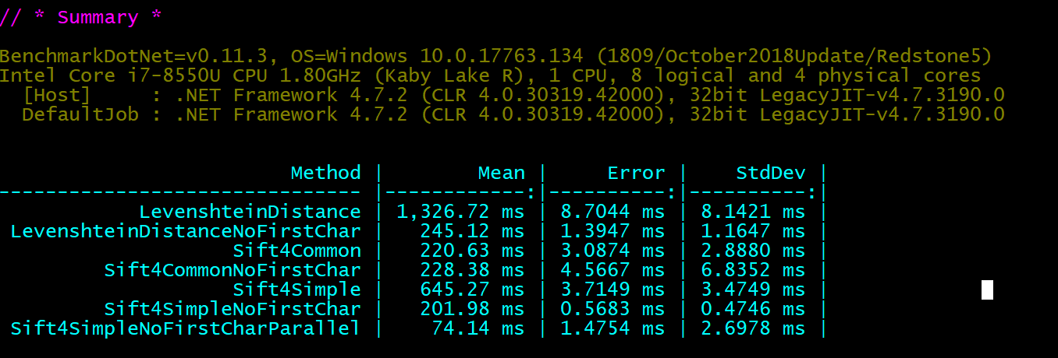
BenchmarkDotNet for tested algorithms
Levenshtein distance
Sift4
Hunspell

Slide 6
How our algorithm works?

Slide 7
Base word
Base word, also known as a root word, is the part of the word that cannot be broken down . The base word gives the word its basic meaning. Prefixes and suffixes change the base word's meaning.
Prefix: which is a letter or letters added to the beginning
Suffix: which is a letter or letters added to the end
Kirdn – Birdn – Xwardn

Slide 8
Variant
Variants are derived from Base words either Prefix, suffix, or pronouns
Xwendn (Base word)
Variants:
Xwendm – xwendt – xwendy – xwendman – xwendtan - xwendyan
OR
Xwendnawa - daxwendranawa

Slide 9
Pattern
Pattern is the structure or Design of the word that show regularity of the words
Our Pattern Design example:
Halmandabzhardn
m
man
t
tan
y
yan
m
man
t
tan
y
yan
Hal
dabzhard

Slide 10
Ignored cases in Pattern
Using two equivalent groups of pronounce in same pattern

Slide 11
Any Question?

